Slide 1
“Teach A Level Maths”
Statistics 1
More Permutations
© Christine Crisp

Slide 2
Statistics 1
OCR
"Certain images and/or photos on this presentation are the copyrighted property of JupiterImages and are being used with permission under license. These images and/or photos may not be copied or downloaded without permission from JupiterImages"

Slide 3

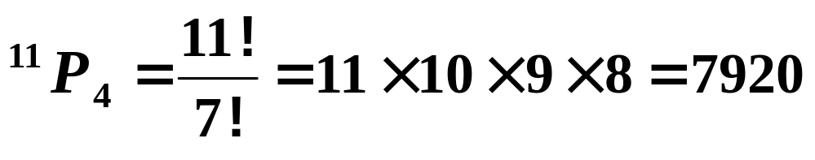
In this presentation, we are going to solve a variety of problems involving arranging.
We’ve already seen that if we have, for example, 11 different objects the number of ways of arranging them in a line is
The formal word for arrangements is permutations.
The number of permutations of 4 of the 11 objects is
We’ll now see what we get if some of the objects are the same.
It’s really important that you try the examples before seeing the solutions so have a pen and paper handy.

Slide 4
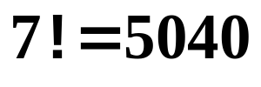
e.g. Suppose we want the number of permutations of the letters of the words
(a) SPINACH (b) CARROTS (c) VEGETABLE
(a) SPINACH
There are 7 different letters so we get
(b) CARROTS
Among the 7 letters, “R” appears twice.
Suppose for the moment we label these as R₁ and R₂.
Then, 2 of the arrangements are
R₁R₂CAOTS
R₂R₁CAOTS
However, these are really the same so among the 5040 arrangements we’ve got this one repeated.
Similarly every other arrangement appears twice.

Slide 5
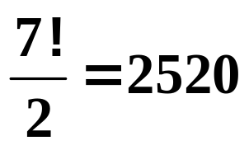


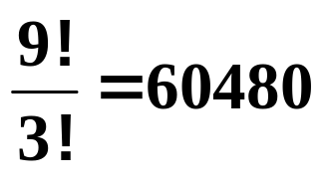
We need to divide the answer by 2, so, the number of arrangements of the letters of the word CARROTS is
To be consistent with other numbers of repeats, we will write this as 2!
Let’s now do (c) VEGETABLE
There are 9 letters with “E” appearing three times.
Can you see how many arrangements there are?
ANS: Considering VE₁GE₂TABLE₃ we would get
We divide as before because of the repeats but we must divide by 6 not 3.
e.g.
VE₁GE₂TABLE₃ VE₁GE₃TABLE₂ VE₂GE₃TABLE₁
VE₂GE₁TABLE₃ VE₃GE₁TABLE₂ VE₃GE₂TABLE₁
These six come from the arrangements of E₁E₂E₃
So, we have

Slide 6
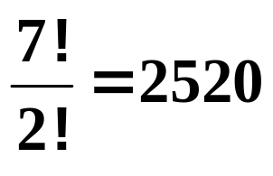
We need to divide the answer by 2, so, the number of arrangements of the letters of the word CARROTS is
Let’s now do (c) VEGETABLE
There are 9 letters with “E” appearing three times.
Can you see how many arrangements there are?
ANS: Considering VE₁GE₂TABLE₃ we would get
We divide as before because of the repeats but we must divide by 6 not 3.
e.g.
VE₁GE₂TABLE₃ VE₁GE₃TABLE₂ VE₂GE₃TABLE₁
VE₂GE₁TABLE₃ VE₃GE₁TABLE₂ VE₃GE₂TABLE₁
These six come from the arrangements of E₁E₂E₃
So, we have

Slide 7



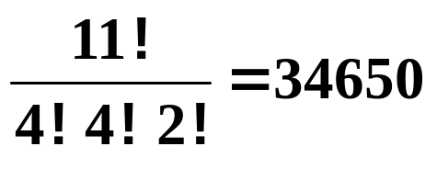

SUMMARY
The number of permutations of the letters of the words
(a) SPINACH (b) CARROTS (c) VEGETABLE
are
(a)
(b)
(c)
Can you see how many arrangements there are of the letters of the word MISSISSIPPI ?
ANS:
4 “I”s and 4 “S”s
2 “P”s

Slide 8

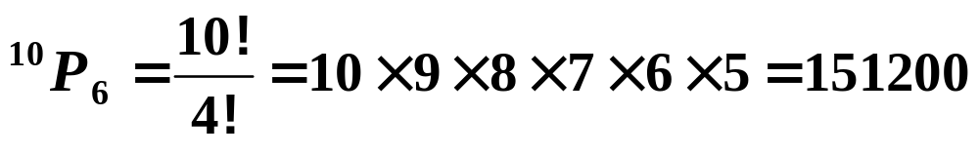
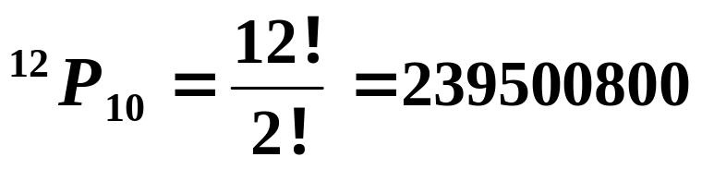
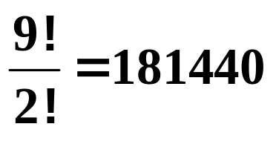
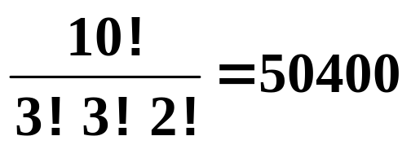

Exercise
1. Find the number of permutations
(a) of 6 objects from 10 different ones,
(b) of 10 objects from 12 different ones.
2. How many arrangements are there of the letters of the following words:
(a) MOVIE
(b) ADVENTURE
(c) STATISTICS
Answers:
1(a)
1(b)
2(a)
(b)
(c)

Slide 9
Formula for Permutations when an object or objects are repeated (e.g. carrots)
The number of distinct permutations of n objects, of which p are identical to each other, and then q of the remainder are identical, and r of the remainder are identical, and so on is
n!
P! x q! x r! x ........
where p+q+r+..... = n

Slide 10


In the next batch of problems we have to either keep some objects together or separate some.
e.g.1 How many permutations are there of the letters of the word TOGETHER if the “E”s must be kept together?
Solution: The easiest method to use here is to bundle the “E”s together and count them as one letter.
So, we have TOG(EE)THR.
We now have the equivalent of 7 different letters, so we get
e.g.2 If in the above, the “E”s have to be at the end of the word, we have 6 letters to arrange and there is just one place for the “E”s, so the answer is

Slide 11

e.g.3 How many permutations are there of the digits 1, 2, 3 and 5 that form even numbers?
Solution: To be even, these numbers must end in 2.
So, leaving the 2 out we get
There is only one way of putting the 2 at the end, so this is the answer.

Slide 12
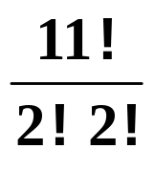

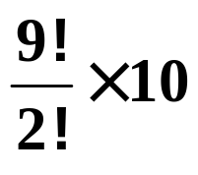
e.g.4 If the letters of the word PROBABILITY are arranged in random order, what is the probability that the 2 “I”s will be separated?
Solution: We need to find the total number of arrangements and the number where the “I”s are separated.
The total number of arrangements is
Without the “I”s, the number of arrangements is
( 2 ”B”s and 2 ”I”s )
Let’s look at just one of these arrangements:
PROBABLTY
We need to insert the “I”s, so separating the letters:
P R O B A B L T Y
I
I
I
I
I
I
I
I
I
I
The 1st “I” can slot into any of the gaps . . .
giving 10 possibilities.
The number of arrangements is now

Slide 13
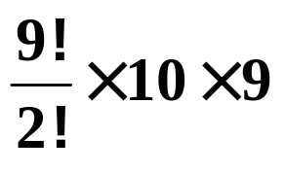
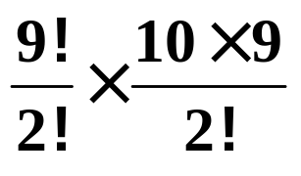
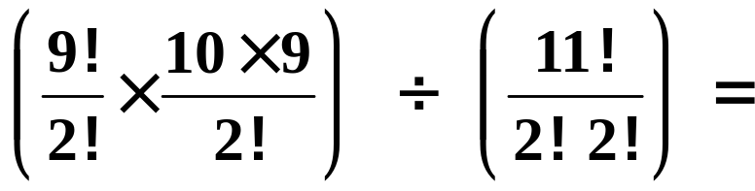
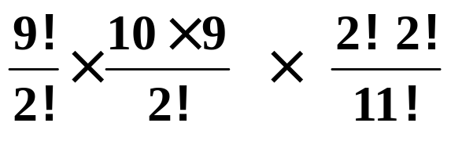
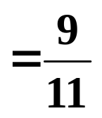

e.g.
P R O B A B L T Y
I₁
The 2nd “I” can now go in 9 places e.g.
P R O B A B L T Y
I₁
I₂
giving
However, the “I”s are the same so we must divide by 2 !
To find the probability of the “I”s being separate we divide by the total number of arrangements:

Slide 14

Exercise
1. Find the number of arrangements of the letters of the following words:
(a) ALPHABET with (i) the “A”s together
(ii) the “A”s separated
(b) MATHEMATICS with the “A”s at the beginning.
2. If 10 students are arranged at random in a line, what is the probability that the youngest is at one end and the eldest at the other?

Slide 15




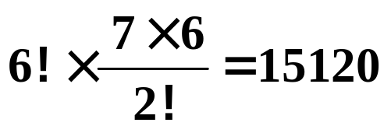
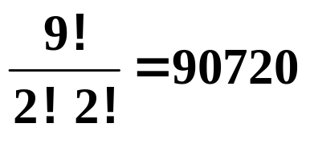
Solutions:
1 (a) ALPHABET with (i) the “A”s together
Bundling the “A”s together gives arrangements.
(a)(ii) ALPHABET with the “A”s separated
Without the “A”s there are arrangements.
Treating the “A”s as 2 different letters:
Inserting the 1st A gives and the 2nd
BUT, we divide by 2 because the “A” s are the same.
So, the answer is
(b) MATHEMATICS with the “A”s at the beginning.
Without the “A”s we have
The “A”s can only go in one place so this is the answer.

Slide 16



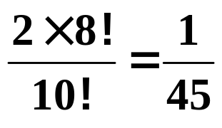
2. If 10 students are arranged at random in a line, what is the probability that the youngest is at one end and the eldest at the other?
Solution: The total number of arrangements is
Leaving out the youngest and eldest gives
Now inserting the youngest and eldest we have
either
Y x x x x x x x x E
or
E x x x x x x x x Y
So the number of arrangements is now
The probability of the youngest at one end and the eldest at the other is

Slide 17


Slide 18
The following slides contain repeats of information on earlier slides, shown without colour, so that they can be printed and photocopied.
For most purposes the slides can be printed as “Handouts” with up to 6 slides per sheet.

Slide 19
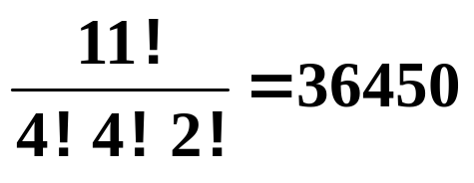
SUMMARY
The number of permutations of the letters of the words
(a) SPINACH (b) CARROTS (c) VEGETABLE
are
(a)
(b)
(c)
Can you see how many arrangements there are of the letters of the word MISSISSIPPI ?
ANS:
4 “I”s and 4 “S”s
2 “P”s

Slide 20
In the next batch of problems we have to either keep some objects together or separate some.
e.g.1 How many permutations are there of the letters of the word TOGETHER if the “E”s must be kept together?
Solution: The easiest method to use here is to bundle the “E”s together and count them as one letter.
So, we have TOG(EE)THR.
We now have the equivalent of 7 different letters, so we get
e.g.2 If in the above, the “E”s have to be at the end of the word, we have 6 letters to arrange and there is just one place for the “E”s, so the answer is

Slide 21
e.g.3 How many permutations are there of the digits 1, 2, 3 and 5 that form even numbers?
Solution: To be even, the numbers must end in 2.
So, leaving the 2 out we get
There is only one way of putting the 2 at the end, so this is the answer.

Slide 22
e.g.4 If the letters of the word PROBABILITY are arranged in random order, what is the probability that the 2 “I”s will be separated?
Solution: We need to find the total number of arrangements and the number where the “I”s are separated.
The total number of arrangements is
Without the “I”s, the number of arrangements is
Let’s look at just one of these arrangements:
PROBABLTY
We need to insert the “I”s, so separating the letters:
P R O B A B L T Y
The 1st “I” can slot into any of the gaps . . .
giving 10 possibilities.
The number of arrangements is now

Slide 23
e.g.
P R O B A B L T Y
I₁
The 2nd “I” can now go in 9 places e.g.
P R O B A B L T Y
I₁
I₂
giving
However, the “I”s are the same so we must divide by 2 !
To find the probability of the “I”s being separate we divide by the total number of arrangements:

